Slide 1
What Does Instructional Technology in Education Mean? Capstone Project
Ashley Chupp
Summer 2012
Instructional Technology M.Ed.

Slide 2
Need
Teachers at Cartersville Middle School need time and training on utilizing available technology. Cartersville Middle School does not have regular trainings on using new or available technology in the classroom. Many teachers are not aware of the technologies available to them.
Teachers also need one-on-one technology support or content-specific technology support.

Slide 3
Plan
Design and offer trainings for interested teachers in using Notebook software, online applications and developing and utilizing Homework Hotline (classroom webpage).
I will also offer teachers that chance to have one-on-one assistance or content-specific assistance in using technology.

Slide 4
Evaluation Plan
Surveys, observations, and discussions with teachers will evaluate effectiveness as well as guide and improve the development of new trainings.
Work samples will be collected to show the results of technology integration.
Teachers will have a chance to share their ideas and success with other faculty members during faculty meetings.

Slide 5
Capstone Experience
Discussed technology needs with teachers.
Met with administration and content coaches to gain support and approval of capstone project.
Trainings offered: Homework Hotline & Twitter, Google Docs & Gmail, Basic Notebook Software, and Online Tools (created wiki for teachers as a resource).
Helped teachers on an as-needed basis with technology and engaging students with technology.
Helped parents with technology needs and resources during parent meetings and during our CMS night.

Slide 6
Results (Responses from Teachers)
I learned to set-up my own website. I feel like it helps my students having access to notes, vocabulary and other resources.
I use Twitter on a regular basis now to inform students of upcoming tests and projects.
We (8th grade social studies department) are having students use Google Docs to keep up with papers and information for Social Studies Fair this year. Thanks for your help! It’s so much easier to keep up with and print student work.
Thanks for helping me create review games for my students using my Smartboard!

Slide 7
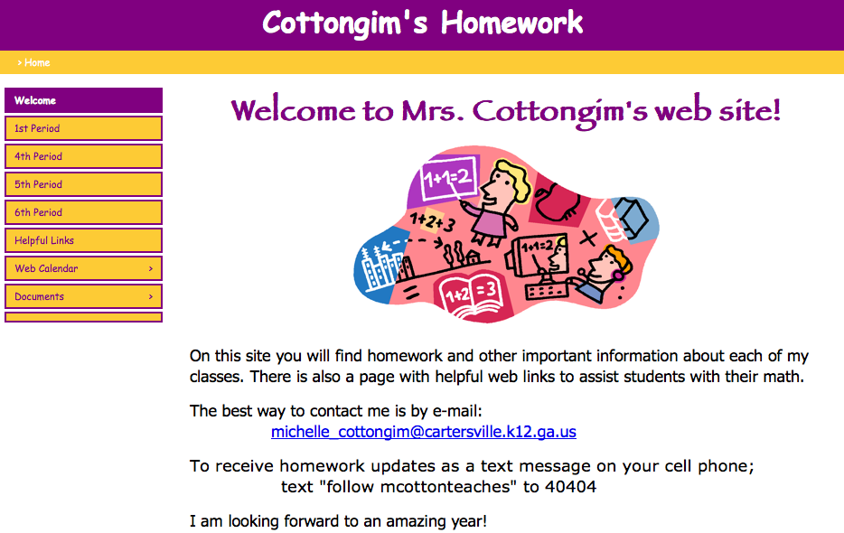
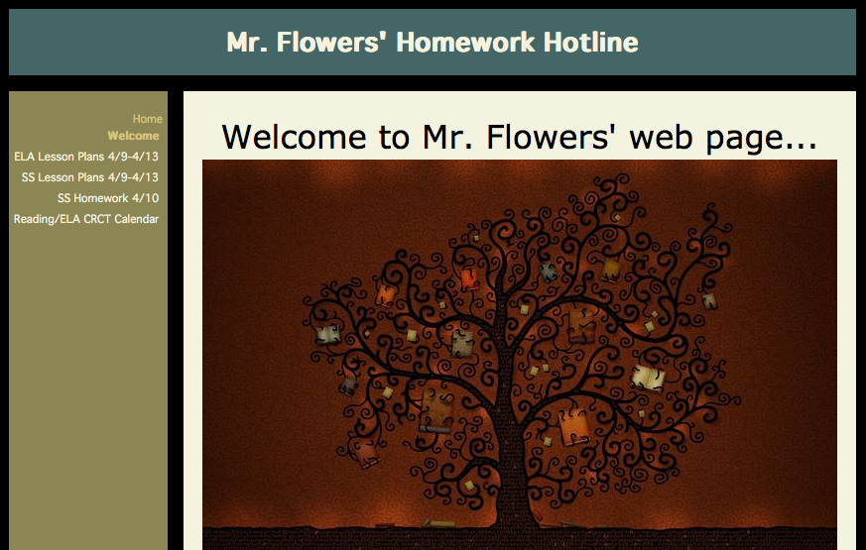
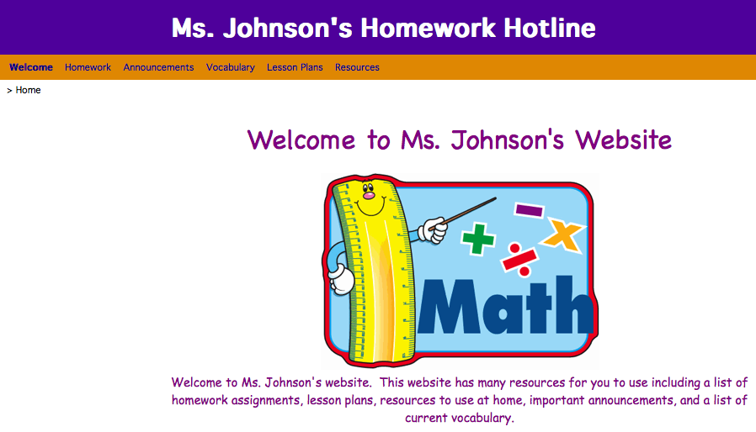
Examples of Teacher Webpages

Slide 8
Results Continued
The capstone project went to plan. My administration supported my efforts and so did many of the teachers at my school. I feel teachers are slowly growing in their technology use. Once I helped a teacher, he or she was able to share that information with teammates or other colleagues.
Teachers gave positive feedback on surveys and looked forward to more technology training.
I expect to continue trainings and helping teachers on an as-needed basis.

Slide 9
Reflection
Cartersville Middle School will continue to need a technology leader in order to share the technology vision of the school.
Teachers responded well to trainings and one-on-one technology assistance. Teachers were able to learn and share with colleagues.
Teachers will continue to need help with integrating technology at Cartersville Middle School.

Slide 10
PSC Standards
Standard 1: Visionary Leadership (1.1, 1.2)
Standard 2: Teaching, Learning & Assessment (2.1, 2.2, 2.3, 2.4, 2.5)
Standard 3: Digital Learning Environments (3.1, 3.2, 3.5, 3.7)
Standard 4: Digital Citizenship & Responsibility (4.2, 4.3)
Standard 5: Professional Learning & Program Evaluation (5.1, 5.2, 5.3)
Standard 6: Candidate Professional Growth & Development: (6.2, 6.3)

